Slide 1


Bibhakta Lamsal
Siddhartha Paudel
Tushar Adhikari
Prabin Thapa
Sulav Katwal

Slide 2

Today's Agenda
01
Mutable classes and object
02
Immutable Classes and Object
03
Difference between it
04
Scope in java
05
Shadowing
06
Queries

Slide 3

Mutable Objects
.
The mutable objects are objects whose value can be changed after initialization.
We can change the object's values, such as field and states, after the object is created.

Slide 4
How to create mutable class?
The following two things are essential for creating a mutable class:
Declare a variable inside class that should be non-final and non-private, allowing them to be modified.
Provide public setter methods that allow the values of the instance variables to be modified. These setter methods should typically have a void return type and accept parameters representing the new values.
Optionally, provide public getter methods that allow access to the current values of the instance variables. These getter methods typically have a return type that matches the type of the corresponding instance variable.
Implement any additional methods and logic specific to class's behavior and requirements.

Slide 5
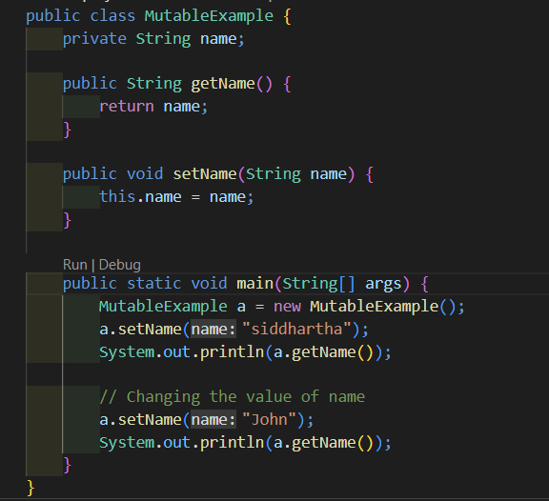
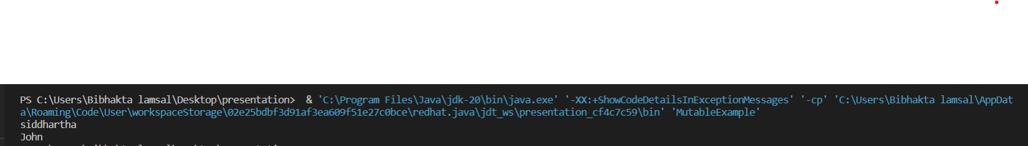
Output:

Slide 6

Immutable Objects
The immutable objects are objects whose value can not be changed after initialization.
Immutable means unmodified or unchangeable.

Slide 7
How to create Immutable class?
The following two things are essential for creating a Immutable class:
Declare the class as final to prevent it from being subclassed.
Make all the instance variables private and final to ensure they cannot be modified once initialized.
Avoid providing any setter methods that modify the state of the object.
Initialize the instance variables in the constructor and ensure they are never modified afterward.
Provide only getter methods to access the values of the instance variables.

Slide 8
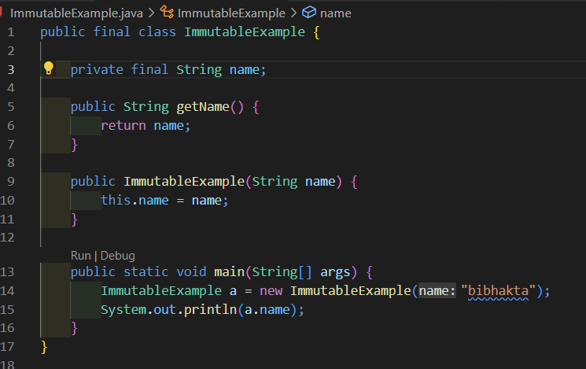

Slide 9
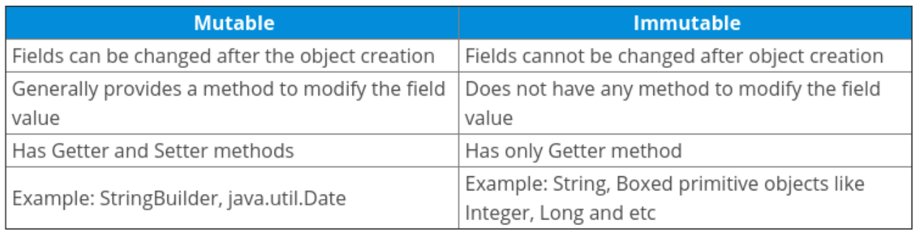




Differnce between mutable and immutable class

Slide 10

Scope In java
scope refers to the visibility or accessibility of variables, methods, and classes within a program.
It determines where a particular entity, such as a variable, can be accessed and used within the code.
There are several levels of scope in Java:
Class Scope
Method Scope
Block Scope
Local Scope
Instance Scope
Static Scope

Slide 11

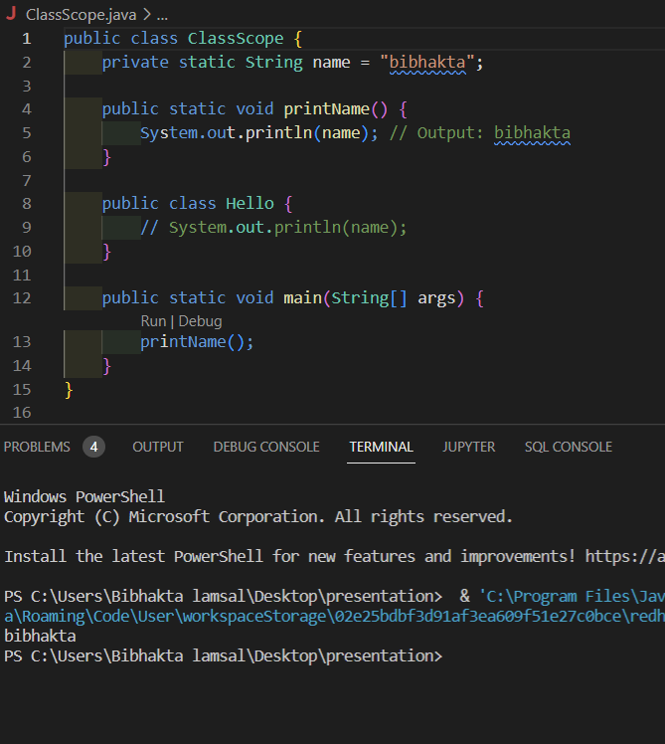
Class Scope
This is the broadest scope and refers to the accessibility of variable according to access modifier used to class such as public, private and protected.

Slide 12
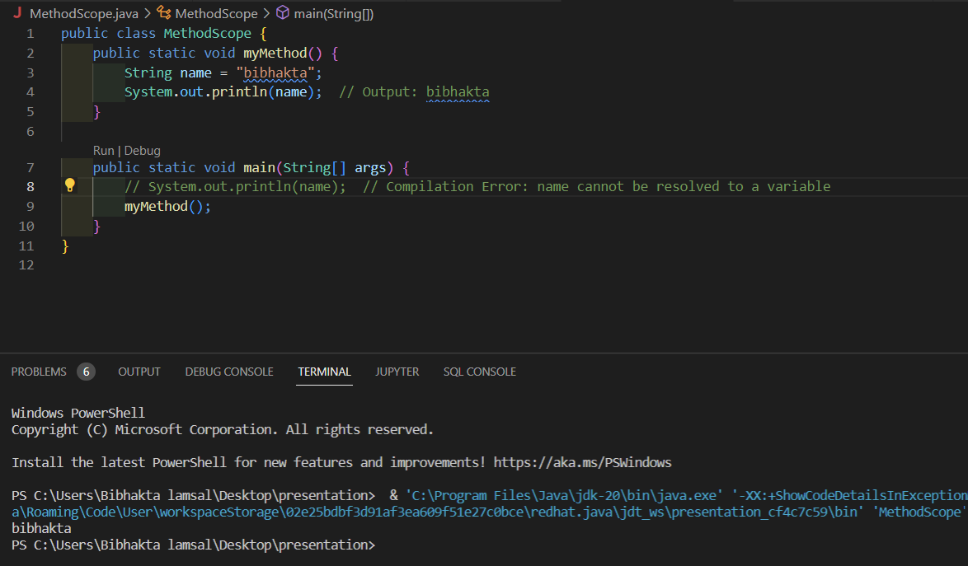
Method Scope or Local Scope
This scope pertains to variables declared within a method. Variables declared within a method are only accessible within that method. They cannot be accessed from outside the method.

Slide 13
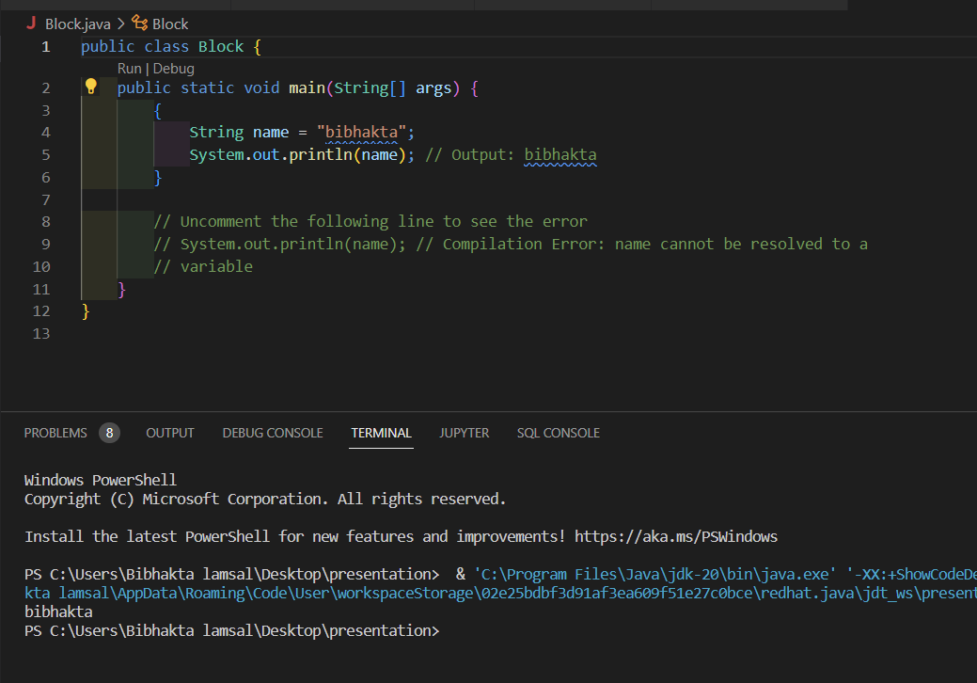
Block Scope
A block in Java is a section of code enclosed within curly braces {}. Variables declared within a block, such as within an if statement, for loop, or a method body, are only accessible within that block. They cannot be accessed from outside the block or from other blocks within the same scope.

Slide 14
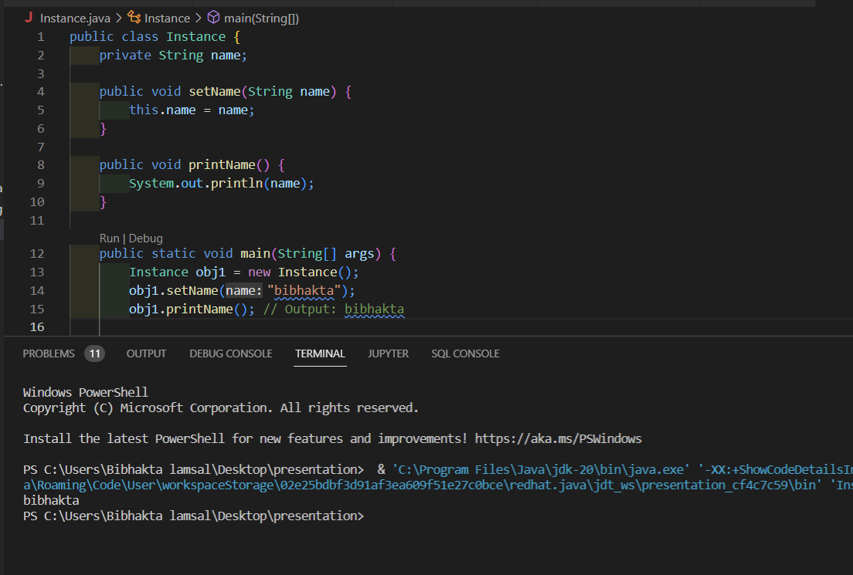
Instance Scope
This scope pertains to instance variables, which are declared within a class but outside of any method. Instance variables are accessible from any method or block within the class and have a lifetime tied to the instance of the class.

Slide 15
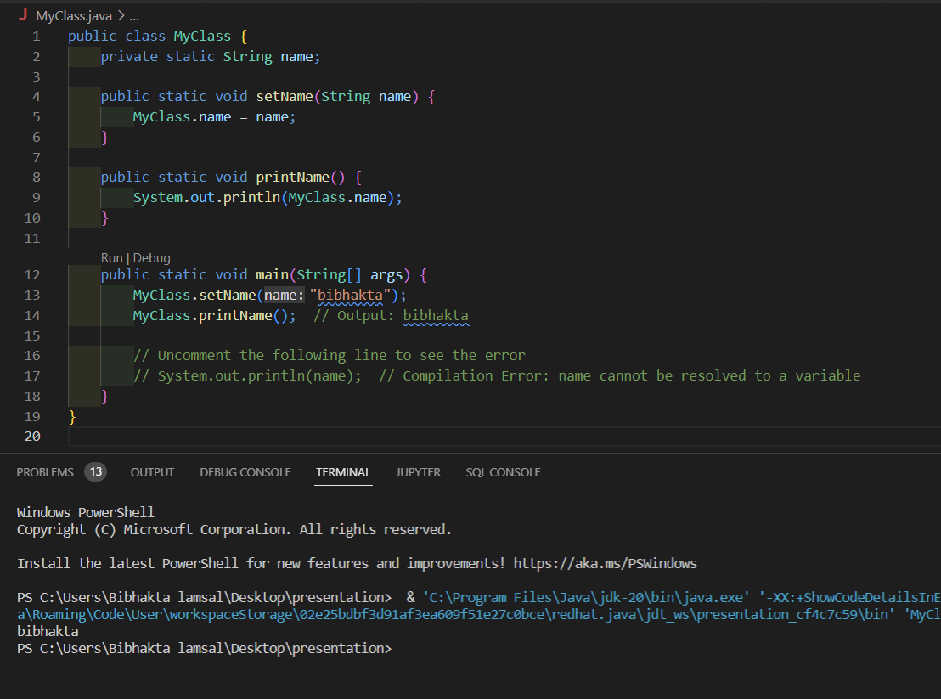
Static Scope
Static variables and methods belong to the class itself rather than to any particular instance. They are shared among all instances of the class. Static variables and methods are accessible from any method or block within the class, regardless of whether an instance has been created.

Slide 16

Shadowing
shadowing refers to the situation where a variable declared within a certain scope has the same name as a variable declared in an outer scope.
The variable declared in the inner scope "shadows" or temporarily hides the variable of the same name in the outer scope, causing it to be inaccessible within that inner scope.

Slide 17
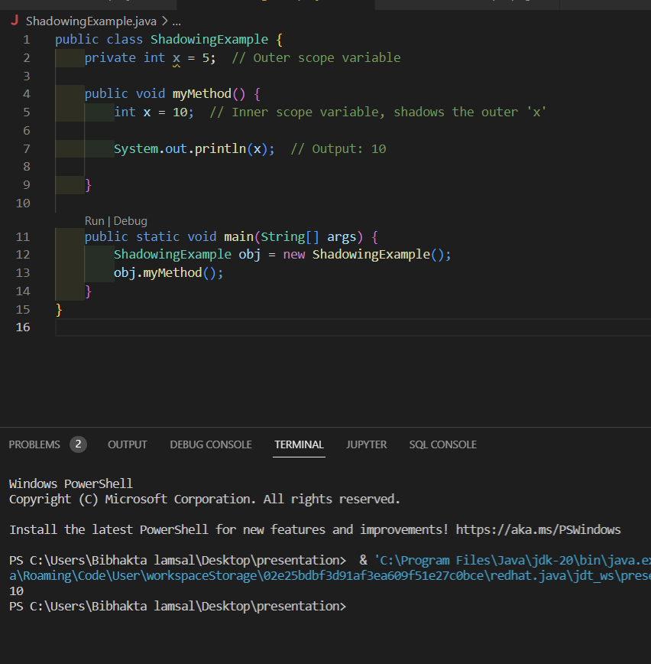

Slide 18

Any Question?

Slide 19

Thank you!

